Slide 1
Containerization and Docker

Slide 2
Outlines
Containerization
Limitations of Virtual Machines
Virtual Machines vs Containers
Container orchestration tools
Introduction to Docker
Containers
Images
Dockerfile
Docker Registry
Networking
Hands-on
Building an image
Running a container
Docker compose and Docker SWARM mode

Slide 3
Containerization

Slide 4
Virtualization vs Containerization
The many advantages of virtualization, such as application containment and horizontal scalability, come at a cost: resources. The guest OS and binaries can give rise to duplications between VMs wasting server processors, memory and disk space and limiting the number of VMs each server can support.
Containerization allows virtual instances to share a single host OS (and associated drivers, binaries, libraries) to reduce these wasted resources since each container only holds the application and related binaries. The rest are shared among the containers.

Slide 5
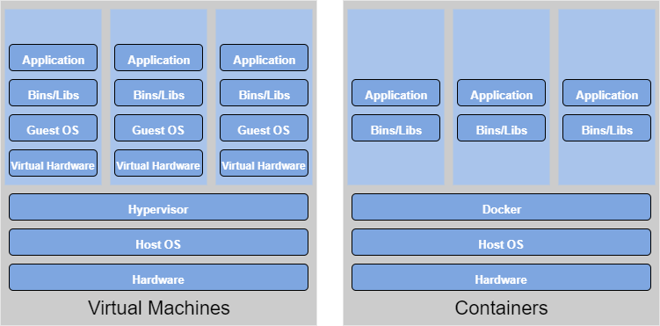
Virtualization vs Containerization
Virtualization Overhead
Shared Bins / Libs

Slide 6
Virtualization vs Containerization
Parameter | Virtual Machines | Containers
Guest OS | Run on virtual HW, have their own OS kernels | Share same OS kernel
Communication | Through Ethernet devices | IPC mechanisms (pipes, sockets)
Security | Depends on the Hypervisor | Requires close scrutiny
Performance | Small overhead incurs | Near native performance
 | when instructions are
 | translated from guest to
 | host OS
Isolation | File systems and libraries are not shared between guest and host OS | File systems can be shared, and libraries are
Startup time | Slow (minutes) | Fast (a few seconds)
Storage | Large size | Small size (most is re-use)

Slide 7
In the Real World, VMs and Containers can/do Co-exist
When deploying applications on the cloud, the base computation unit is a Virtual Machine. Usually Docker containers are deployed on top of VMs.

Slide 8
Are Containers Better than VMs?
It depends …
The size of the task on hand
The life span of the application
Security concerns
Host operation system
Containers vs Virtual Machines: Which is a better fit for you?
Containers vs Virtual Machines: How to tell which is the right choice for your enterprise?

Slide 9
What is a Container?
Similar concept of resource isolation and allocation as a virtual machine.
Without bundling the entire hardware environment and full OS.

Slide 10

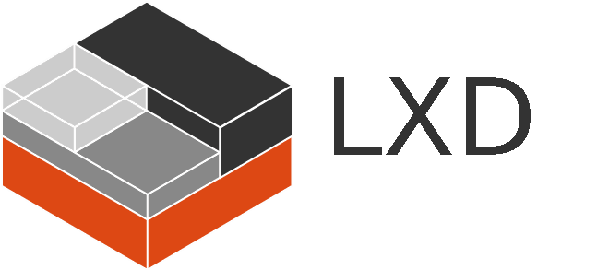

What container runtimes are in use?
Container technologies: Docker, containerd, cri-o, rkt, LxD ...
Docker is currently the leading software container platform

Slide 11
What are Container Orchestration Tools?
Container orchestration technologies provides a framework for integrating and managing containers at scale
Features:
Networking
Scaling
Service discovery and load balancing
Health check and self-healing
Security
Rolling updates
Goals:
Simplify container management processes
Help to manage availability and scaling of containers

Slide 12
Container Orchestration Tools
Kubernetes and Hosted Kubernetes:
Docker SWARM / Docker Compose
Others:
OpenShift
Amazon Elastic Container Service (ECS)
Apache Mesos

Slide 13
Introduction to Docker
“Leads the pack with a robust container platform well-suited for the enterprise”
The Forrester New Wave Enterprise Container Platform, Q4 2018 Report

Slide 14
Docker
Docker is by far the most successful containerization technology.
Over 3.5 million applications have been placed in Docker containers and over 37 billion containerized applications have been downloaded (March 2018, according to Docker).
It uses resource isolation features of the Linux kernel to allow independent “containers” to run within a single Linux instance.
Docker can also be installed on Mac and Windows computers. It it is deeply integrated with the macOS Hypervisor framework and Microsoft Hyper-V virtualization or LCOW.

Slide 15
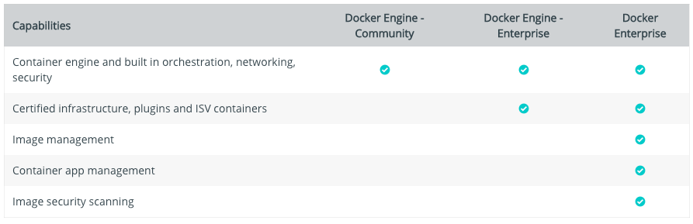
Docker
Microsoft have announced native support for Docker.
Native Windows apps can now be built, shipped and run in Docker containers that work on both Windows Server 2016 and Windows 10 Enterprise.
Docker versions:
Docker CE (Community Edition, free)
Docker EE (Enterprise Edition, $$$, USD$750 - USD$3500+ per node per year)

Slide 16
Install Docker
How to install Docker:
Get Docker CE for Linux (Ubuntu)
Get Docker CE for Mac
Get Docker CE for Windows
Get Docker Compose
Linux Container on Windows: https://docs.microsoft.com/en-us/virtualization/windowscontainers/deploy-containers/linux-containers
Share Linux kernel
No more VirtualBox, but LinuxKit VM on macOS,
LinuxKit VM / LCOW on Windows

Slide 17
A Bit of Docker Nomenclature
Container: a process that behaves like an independent machine, it is a runtime instance of a docker image.
Image: a blueprint for a container.
Dockerfile: the recipe to create an image.
Registry: a hosted service containing repositories of images. E.g., the Docker Hub (https://hub.docker.com)
Repository: is a sets of Docker images.
Tag: a label applied to a Docker image in a repository.
Docker Compose: Compose is a tool for defining and running multi-containers Docker applications.
Docker SWARM: a standalone native clustering / orchestration tool for Docker.

Slide 18
Manage Data in Docker
By default, data inside a Docker container won’t be persisted when a container is no longer exist.
You can copy data in and out of a container.
Docker has two options for containers to store files on the host machine, so that the files are persisted even after the container stops.
Docker volumes (Managed by Docker, /var/lib/docker/volume/)
Bind mounts (Managed by user, any where on the file system)

Slide 19
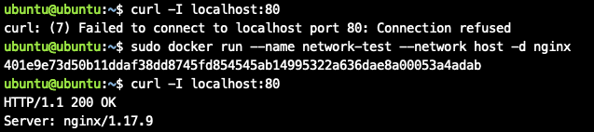
Networking
Docker has different networking options:
“host”: every container uses the host network stack; which means all containers share the same IP address, hence ports cannot be shared across containers (Linux only, not for macOS or Windows)
Nginx container running on “host” network on an Ubuntu Server

Slide 20
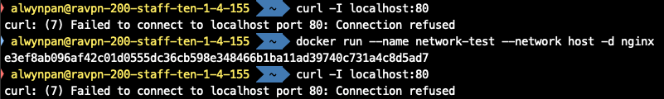
Networking
Nginx container running on “host” network on macOS
Nginx container running on “host” network on Windows

Slide 21
Networking
“bridge”: containers can re-use the same port, as they have different IP addresses, and expose a port of their own that belongs to the hosts, allowing the containers to be somewhat visible from the outside.
Read more: https://docs.docker.com/network/

Slide 22
Hands-on

Slide 23
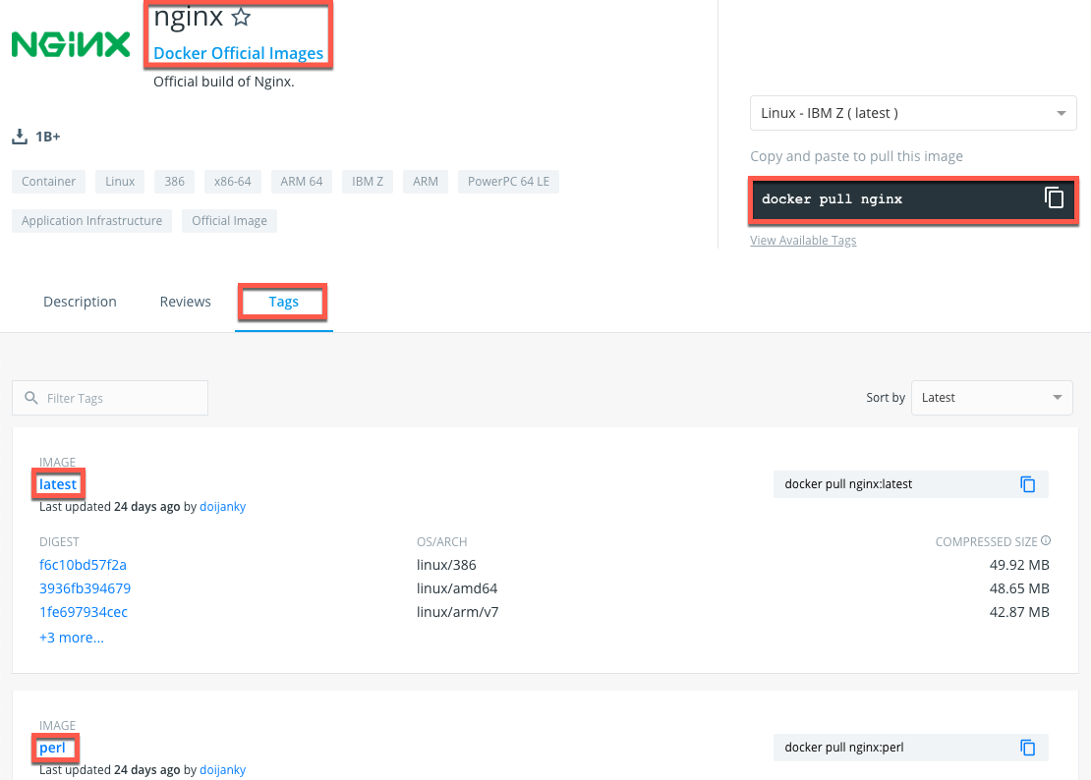
Docker Image
Public Docker registry (Where you can find the images)
https://hub.docker.com
Docker image name
Syntax: [registry hostname]/repository[:tag]
E.g.: [docker.io/]nginx:alpine or nginx[:latest]

Slide 24
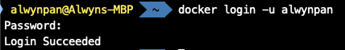
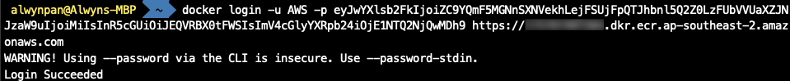
Login to a Docker Registry
Login to a public Docker Registry, i.e. Docker Hub.
Syntax: docker login [OPTIONS] [SERVER]
E.g.: docker login --username=foo
Login to a private Docker Registry (e.g., AWS ECR, Nexus Server)
E.g.: docker login -u AWS https://ecr.ap-southeast-2.amazonaws.com
Logout
Syntax: docker logout [SERVER]
E.g.: docker logout

Slide 25
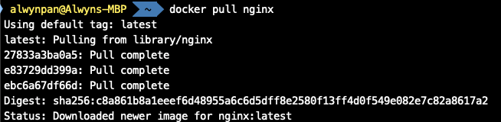
Pulling a Docker Image
Pull an image from a public Docker Registry, i.e. Docker Hub.
Syntax: docker pull NAME[:TAG]
E.g.: docker pull nginx
List all images
Syntax: docker images [OPTIONS] [REPOSITORY[:TAG]]
E.g.: docker images

Slide 26
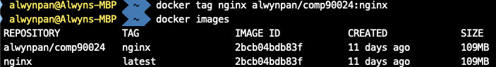
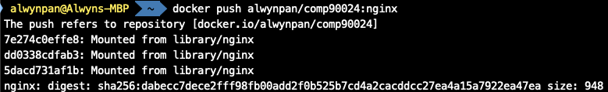
Pushing a Docker Image
(Optional) Tag an image
Syntax: docker tag <SOURCE_IMAGE> <TARGET_IMAGE>
E.g.: docker tag nginx alwynpan/comp90024:nginx
Push an image
Syntax: docker push <NAME[:TAG]>
E.g.: docker push alwynpan/comp90024:nginx

Slide 27
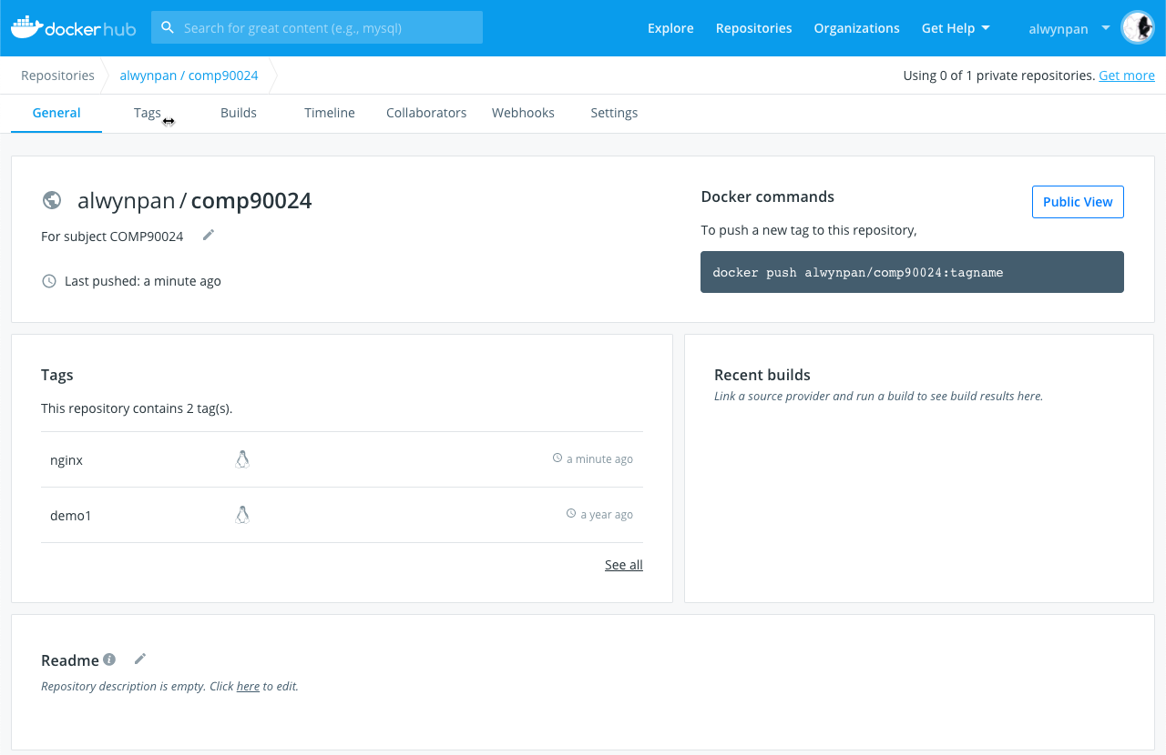
Pushing a Docker Image

Slide 28
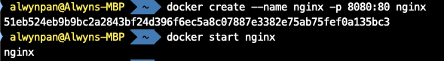
Run a Docker Container
(Option 1) Create a container, then start the container
Syntax: docker create [OPTIONS] IMAGE [COMMAND] [ARG …]
E.g.: docker create --name nginx -p 8080:80 nginx
Syntax: docker start [OPTIONS] CONTAINER [CONTAINER …]
E.g.: docker start nginx
(Option 2) Run a container
Syntax: docker run [OPTIONS] IMAGE [COMMAND] [ARG …] E.g.: docker run --name nginx -p 8080:80 -d nginx

Slide 29
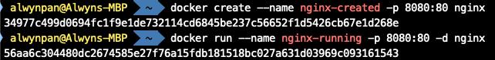
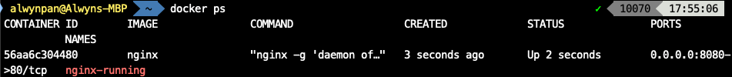
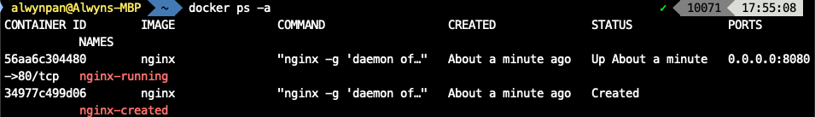
List Docker Containers
List running containers
Syntax: docker ps [OPTIONS]
E.g.: docker ps
List all containers
docker ps -a

Slide 30
Stop / Restart / Remove a Docker Container
Restart a container
Syntax: docker restart [OPTIONS] CONTAINER [CONTAINER …]
E.g.: docker restart nginx
Stop the container
Syntax: docker stop [OPTIONS] CONTAINER [CONTAINER …]
E.g.: docker stop nginx
Remove a non-running container
Syntax: docker rm [OPTIONS] CONTAINER [CONTAINER …]
E.g.: docker rm nginx
Remove a running container
docker rm -f nginx

Slide 31
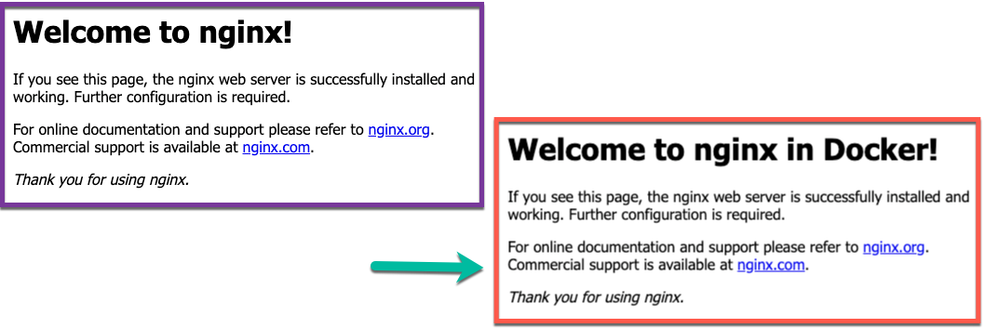
Running a Shell within a Container
Containers can be started and stopped, and behave like VMs. Instead of using SSH to access a VM, a container can be accessed with exec command.
(Not recommended, mainly for debug or testing purpose.)
Syntax: docker exec [OPTIONS] CONTAINER COMMAND [ARG …]
E.g.: docker exec -ti -w /usr/share/nginx/html/ nginx sh
sed -i 's/nginx!/nginx in Docker!/g' index.html

Slide 32
Demo 1: Manage data in Docker
Create a volume
Syntax: docker volume create [OPTIONS] [VOLUME]
E.g.: docker volume create --name htdocs
Start a container with a volume attached
E.g.: docker run --name nginx-volume -p 8080:80 \
-v htdocs:/usr/share/nginx/html -d nginx
Start a container with bind mount attached
E.g.: docker run --name nginx-bind -p 8081:80 \
-v $(pwd)/htdocs:/usr/share/nginx/html -d nginx
With named volume, the content of the container (index.html etc) was there, but with bind mount the directory was empty. Why?
A new named volume’s contents can be pre-populated by a container.

Slide 33
What's in a Dockerfile
FROM nginx:latest
ENV WELCOME_STRING "nginx in Docker"
WORKDIR /usr/share/nginx/html
COPY ["./entrypoint.sh", "/"]
RUN cp index.html index_backup.html; \
chmod +x /entrypoint.sh; \
apt-get update && apt-get install -qy vim
ENTRYPOINT ["/entrypoint.sh"]
CMD ["nginx", "-g", "daemon off;"]
Run at build time
Run at start up

Slide 34
ENTRYPOINT
ENTRYPOINT gets executed when the container starts. CMD specifies arguments that will be fed to the ENTRYPOINT.
Unless it is overridden, ENTRYPOINT will always be executed.
#!/usr/bin/env sh
# Replace the substring with the value of the environment variable ${WELCOME_STRING}
sed -i 's/Welcome to nginx!/Welcome to '"${WELCOME_STRING}"'!/g' /usr/share/nginx/html/index.html
# Make the entrypoint a pass through, then runs the docker command. By default “$@” variable points to the command line arguments.
exec "$@“
# nginx -g “daemon off”

Slide 35
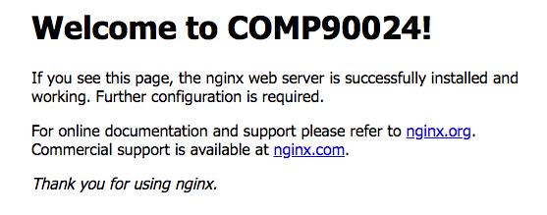
Demo 2: Create an image
Create an image
Syntax: docker build [OPTIONS] PATH
E.g.: docker build -t demo2 .
Create a container from the image
docker run --name demo2 -e WELCOME_STRING="COMP90024" \
-p 8081:80 -d demo2

Slide 36
Demo 3: WordPress + MySQL + phpMyAdmin
WordPress is a free and open-source content management system based on PHP and MySQL.
Demo 3: use Compose file to start a WordPress website including WordPress, MySQL and phpMyAdmin.
Start the containers
Syntax: docker-compose up [OPTIONS]
E.g.: docker-compose up -d
Stop the containers
Syntax: docker-compose stop [OPTIONS] [SERVICE …]
E.g.: docker-compose stop
Remove the containers
Syntax: docker-compose down [OPTIONS]
E.g.: docker-compose down

Slide 37
Docker SWARM
What is Docker SWARM (the correct name: Docker in SWARM mode)?
It is a Docker orchestration tool.
Why Docker SWARM?
Hundreds of containers to manage?
Scalability
Self-healing
Rolling updates
And more …

Slide 38
Docker SWARM
Raft consensus group consists of internal distributed state store and all manager nodes.
Internal Distributed State Store is a built-in key-value store of Docker Swarm mode.
Manager Node conducts orchestration and management tasks. Docker Swarm mode allows multiple manager nodes in a cluster. However, only one of the manager nodes can be selected as a leader.
Worker Node receives and executes tasks directly from the manager node
Node Availability: In Docker Swarm mode, all nodes with ACTIVE availability can be assigned new tasks, even the manager node can assign itself new tasks (unless it is in DRAIN mode).
Service consists of one or more replica tasks which are specified by users when first creating the service.
Task: A task in Docker Swarm mode refers to the combination of a single docker container and commands of how it will be run.

Slide 39
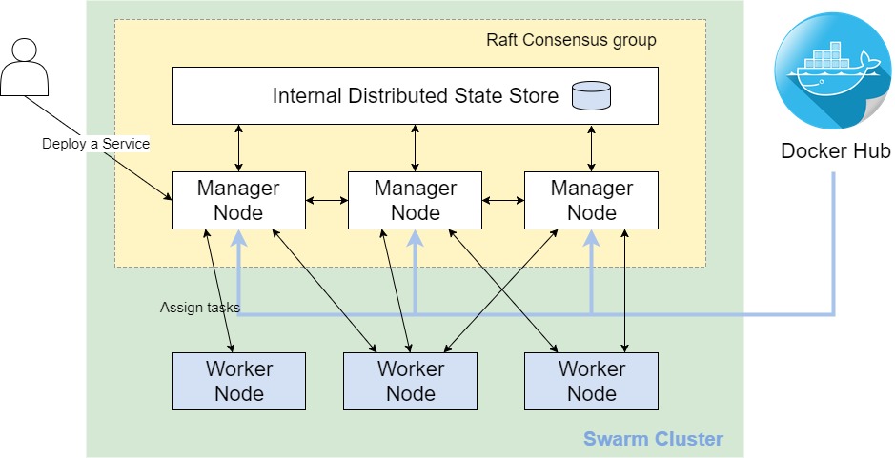
Docker SWARM

Slide 40
Demo 4: Docker in SWARM mode
Docker Machine lets you install Docker Engine on virtual hosts, and manage the hosts with docker-machine commands. You can use Docker Machine to create Docker hosts on a local computer, across a network, in a data centre, or on cloud providers.
In this demo we will create one manager and two workers.
Syntax: docker-machine create [OPTIONS] [ARG…]
docker-machine create manager
docker-machine create worker1
docker-machine create worker2
For Windows users:
docker-machine create --driver hyperv \
--hyperv-virtual-switch <vswitch-name> manager
https://docs.docker.com/machine/drivers/hyper-v/

Slide 41
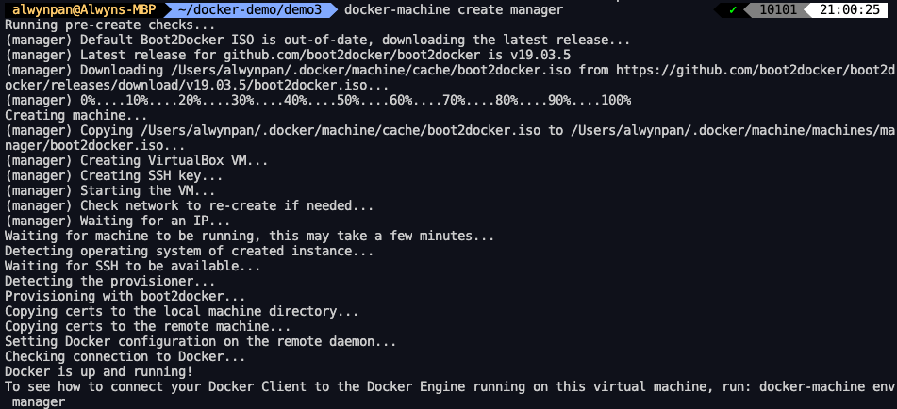
Demo 4: Create Docker Machines

Slide 42
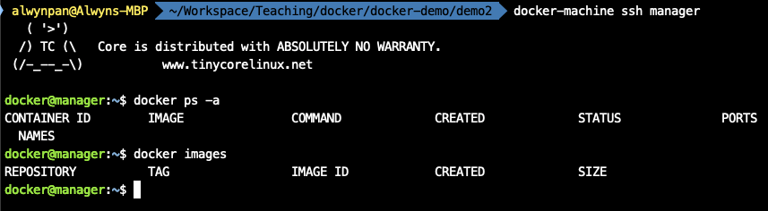
Demo 4: Docker Machines
docker-machine ls
docker-machine ssh manager

Slide 43
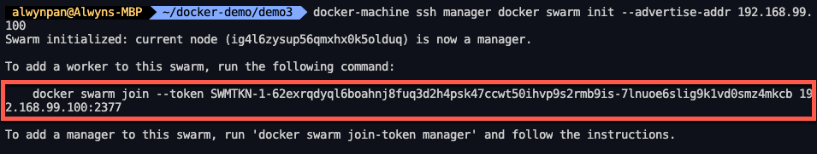
Demo 4: Create a Docker SWARM
Syntax: docker swarm init [OPTIONS]
docker swarm init --advertise-addr 192.168.99.100
docker-machine ssh manager docker swarm join-token manager

Slide 44
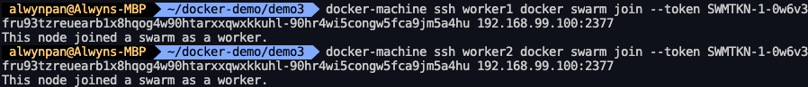
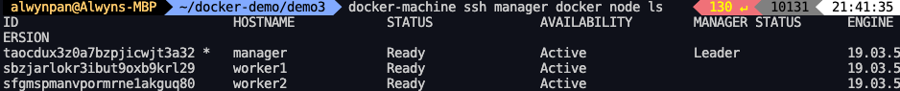
Demo 4: Join a Docker SWARM
Syntax: docker swarm join [OPTIONS]
docker-machine ssh worker1 docker docker swarm join --token SWMTKN-1-2uj8tpltiekyk1e5n4dcugcokjo8a2cfuvgby9s8ru8jwgg6q2-f3xw8888sfw0ayvgrcuv4efam 192.168.99.100:2377
docker-machine ssh manager docker node ls

Slide 45
Demo 4: Create a Service
Create a service
Syntax: docker service create [OPTIONS] IMAGE [COMMAND]
docker-machine ssh manager docker service create --replicas 3 -p 8083:80 --name nginx nginx:alpine
List a service
Syntax: docker service ls [OPTIONS]
docker-machine ssh manager docker service ls
Check a service
Syntax: docker service ps [OPTIONS] SERVICE [SERVICE …]
docker-machine ssh manager docker service ps nginx
What if one of the containers stops?
It is self-healing …

Slide 46
Demo 4: Scaling and Rolling Update
Scale up / down
Syntax: docker service scale SERVICE=REPLICAS
docker-machine ssh manager docker service scale nginx=6
docker-machine ssh manager docker service scale nginx=2
Rolling update
Syntax: docker service update [OPTIONS] SERVICE
docker-machine ssh manager docker service update --image alwynpan/comp90024:demo1 nginx

Slide 47
References
Bigelow, S. J. (n.d.). How is containerization different from virtualization? Retrieved from Search Server Virtualization
Docker Inc. (n.d.). Docker. Retrieved from Docker: https://www.docker.com/
Sysdig (29 Oct 2019). 2019 Docker Usage Report:
https://sysdig.com/blog/sysdig-2019-container-usage-report/

